Slide 1




P. R. Pote Patil College of Engineering & Management, Amravati
Department of Computer Science & Engineering
Presentation on
NextGen Careers: Navigating Careers with AI
Presented By
Ombhushan U. Adokar
Vedant M. Lavhale
Shreyash G. Bhojane
Anshul D. Kalamkar
Guided By
Prof. M. K. Nichat
Year 2024-25
Notes:
qqqq

Slide 2

Index
.
Sr. No. | Chapter/Title | Slide No.
1 | Introduction | 3
2 | Aim and Objectives | 4
3 | Problem Statement | 5
4 | Literature Survey | 6
5 | Idea/Methodology | 7
6 | Screenshots/Results | 8
7 | Result Analysis | 9
8 | Advantages and Disadvantages | 10
9 | Conclusion and Future Scope | 11
10 | References | 12
PRPCEM, CSE Department
1

Slide 3
Introduction
In today’s fast-paced world, career guidance plays a crucial role in shaping the future of students. However, traditional methods often lack personalization and real-time assistance. To bridge this gap, we have developed NextGEN Career, an intelligent career counseling system that leverages machine learning to provide career recommendations based on students' interests, skills, and academic performance.
Our project aims to empower students with accurate career predictions, helping them make informed decisions about their professional paths. With the integration of data-driven insights and AI-based analysis, this system serves as a virtual career advisor, providing instant and personalized career guidance.
PRPCEM, CSE Department
1

Slide 4
AIM & Objectives
Aim:
To develop an AI-powered career guidance system, NextGEN Career, that provides personalized career recommendations based on students' skills, interests, and academic performance, helping them make informed career choices.
Objectives:
Personalized Career Recommendations – Utilize machine learning algorithms to analyze student data and suggest suitable career paths.
Skill & Interest-Based Matching – Assess students' strengths, weaknesses, and interests to align them with the most relevant career options.
User-Friendly Interface – Develop an interactive platform where students can easily input their preferences and receive career suggestions.
Data-Driven Decision Making – Enhance career counseling with AI-based predictions backed by historical data and patterns.
Improved Career Awareness – Help students explore a wide range of career paths beyond conventional options.
PRPCEM, CSE Department
1

Slide 5
Problem statement
Choosing the right career path is a challenging decision for students, often influenced by limited awareness, peer pressure, or lack of proper guidance. Traditional career counseling methods are time-consuming, subjective, and may not provide personalized recommendations based on an individual's skills, interests, and academic performance.
This project, NextGEN Career , aims to solve this issue by leveraging machine learning to provide data-driven career recommendations. By analyzing a student's academic background, interests, strengths, and preferences, the system offers personalized career suggestions, helping students make informed career choices with confidence.
PRPCEM, CSE Department
1

Slide 6
Literature Survey
AI in Career Prediction: Recent research shows that AI-based career prediction systems enhance decision-making by analyzing multiple factors such as skills, interests, and academic performance (Jain et al., 2022).
Machine Learning for Career Guidance: Studies indicate that Random Forest and Decision Trees provide accurate career recommendations by analyzing student data and predicting suitable career paths (Ahmad & Qazi, 2021).
Personalized Career Counseling: AI-driven models offer personalized career guidance, improving student satisfaction and confidence in career decisions (Kumar et al., 2023).
Handling Imbalanced Data with SMOTE: Implementing Synthetic Minority Over-sampling Technique (SMOTE) ensures fair career predictions by addressing class imbalance in datasets (Chawla et al., 2022).
AI-Based Educational Assistants: Intelligent systems bridge gaps in career counseling, especially in regions where access to human counselors is limited (Sharma & Verma, 2023).
Impact on Student Confidence: AI-powered career recommendation tools improve students' decision-making skills, helping them make informed career choices (Patel et al., 2023).
PRPCEM, CSE Department
1

Slide 7
Idea / Methodology
Start: This is the entry point of the system. Users begin their journey here, typically by accessing the application or website.
Login/Register: Users are prompted to either log in if they already have an account or register if they are new.
Personalized Dashboard: The dashboard is customized based on the user's profile, preferences, or past interactions.
Decision Point: Test Given or Not:
  This decision point branches into two scenarios:
    If Test is Not Given:
      The system prompts the user to take the test.
      The test could be related to skills, personality, preferences, or any other relevant assessment.
    If Test is Given:
      The system allows the user to interact with a ChatBot.
      The ChatBot may provide personalized recommendations, answer queries, or guide the user based on the test results.
Give Test: If the user has not taken the test, they are directed to complete it.
Ask to ChatBot:
  If the user has already taken the test, they can interact with a ChatBot.
  The ChatBot leverages the test results to provide tailored assistance or recommendations.
Logout: Users can log out of the system at any time.
1

Slide 8
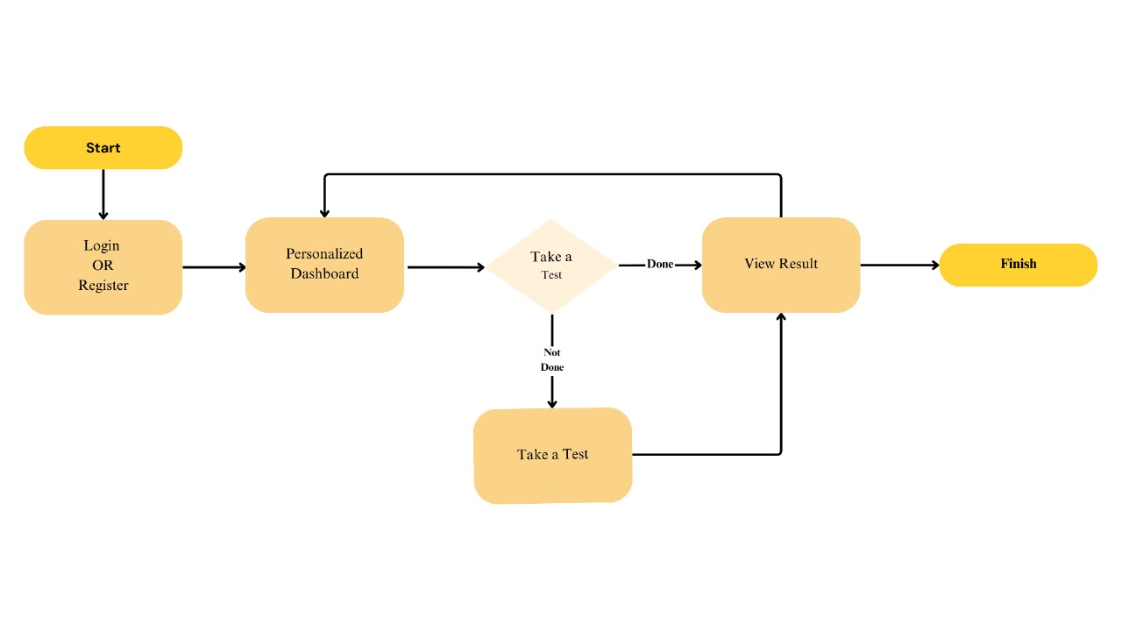
Idea / Methodology
PRPCEM, CSE Department
1

Slide 9

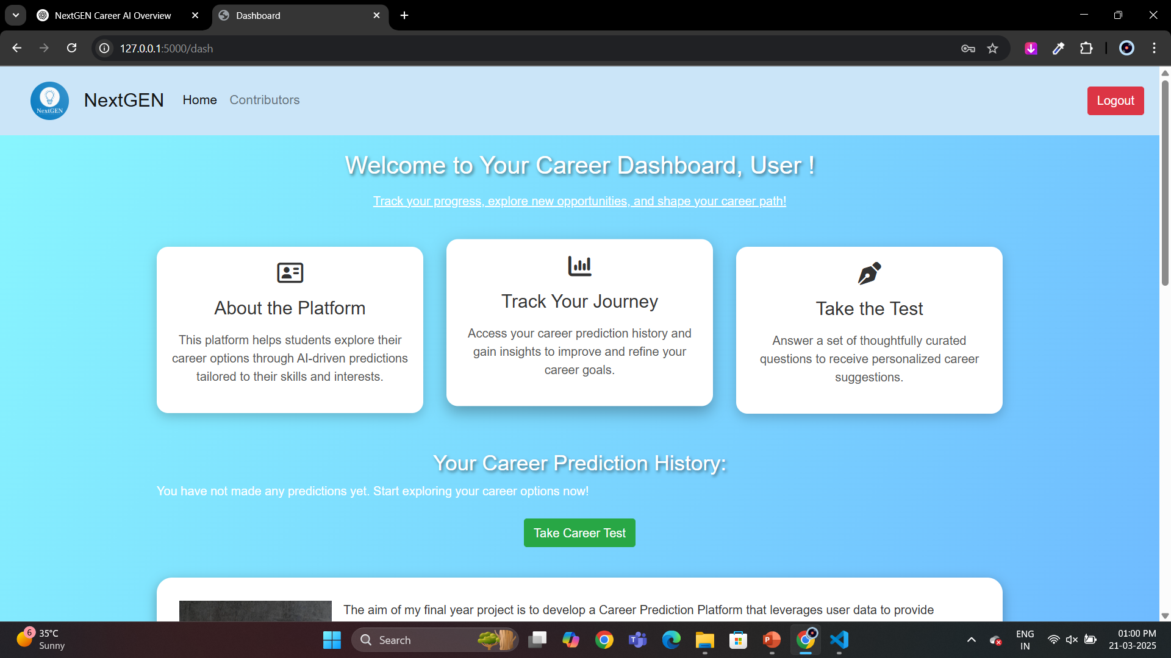
Screen shots/ Results
PRPCEM, CSE Department
1

Slide 10
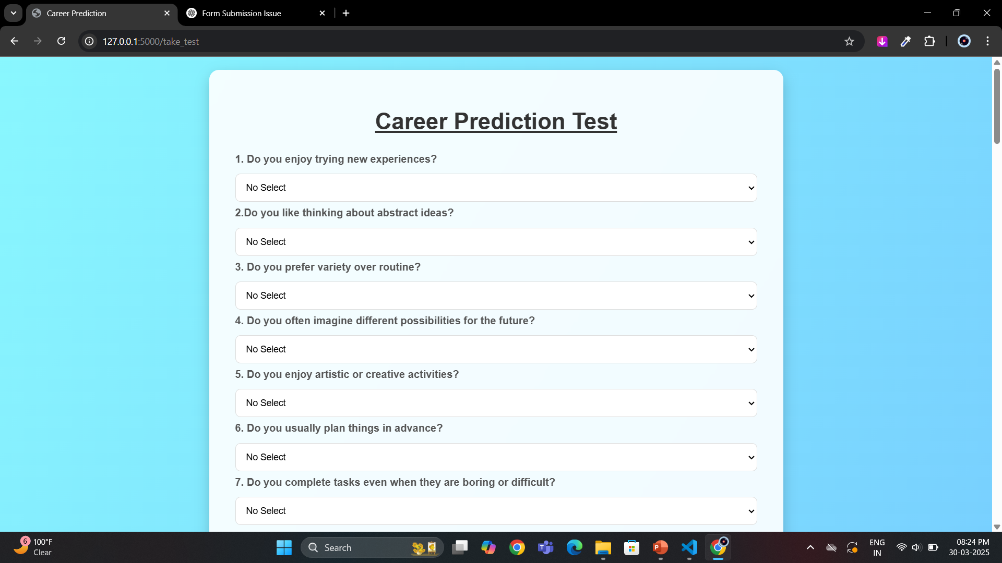
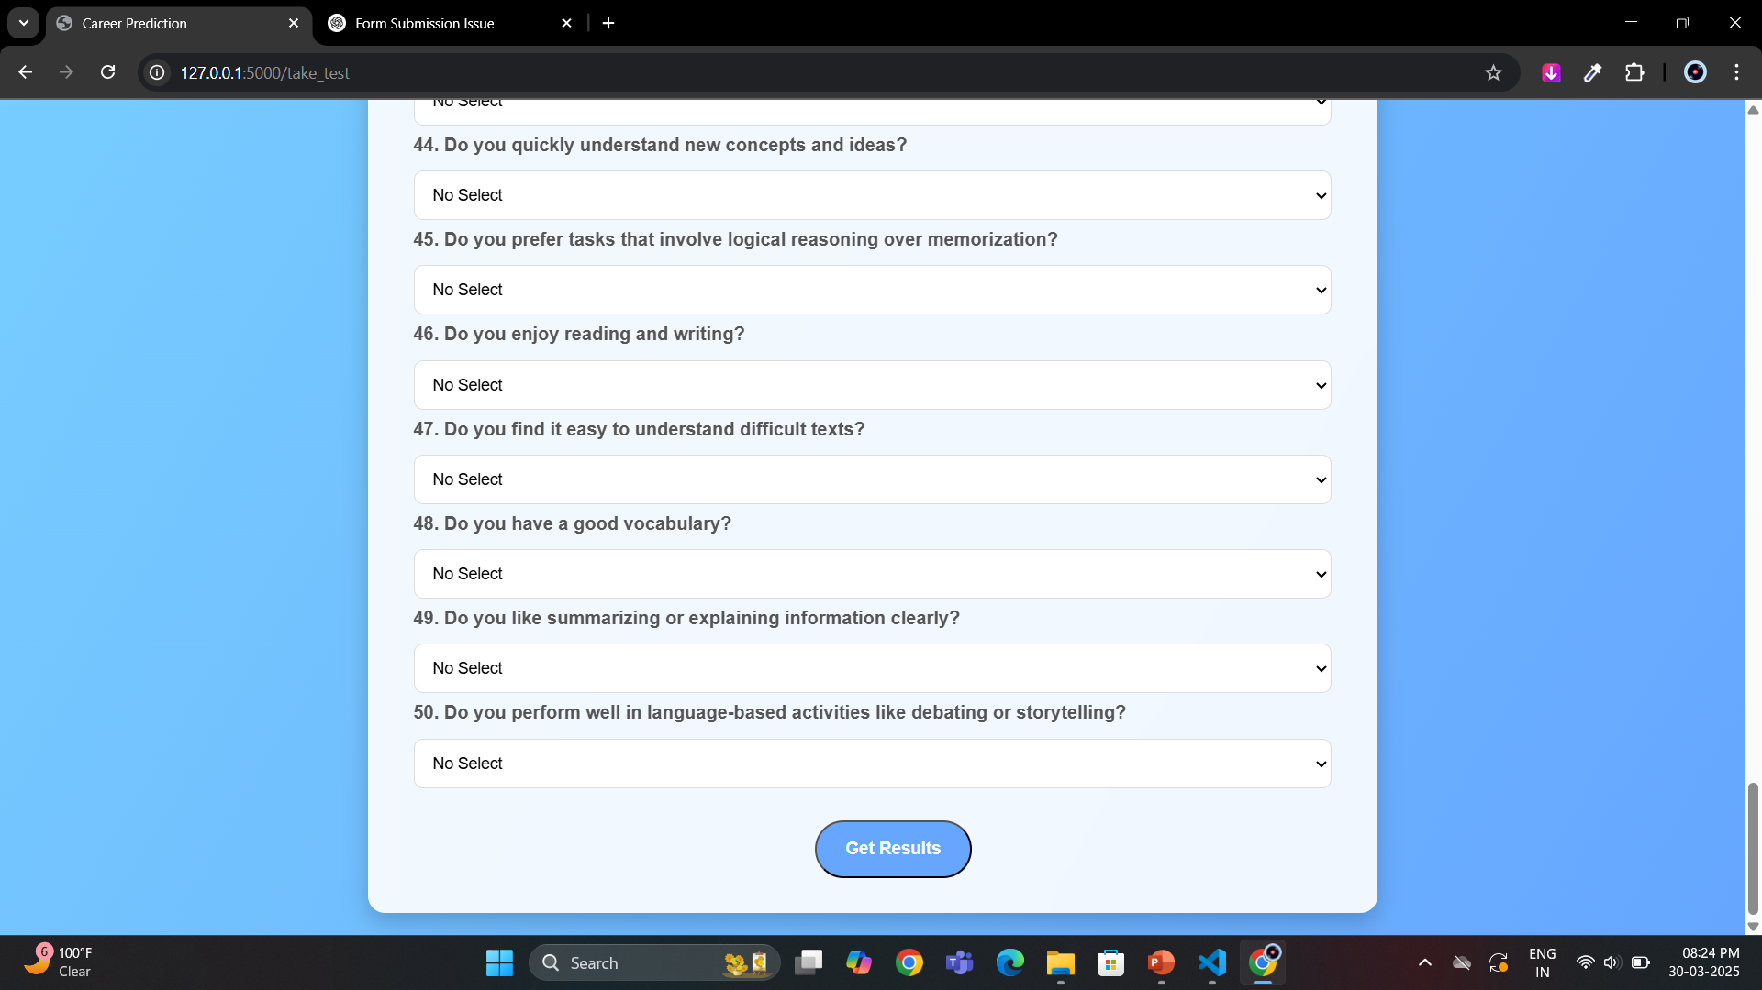
Screen shots/ Results
PRPCEM, CSE Department
1

Slide 11
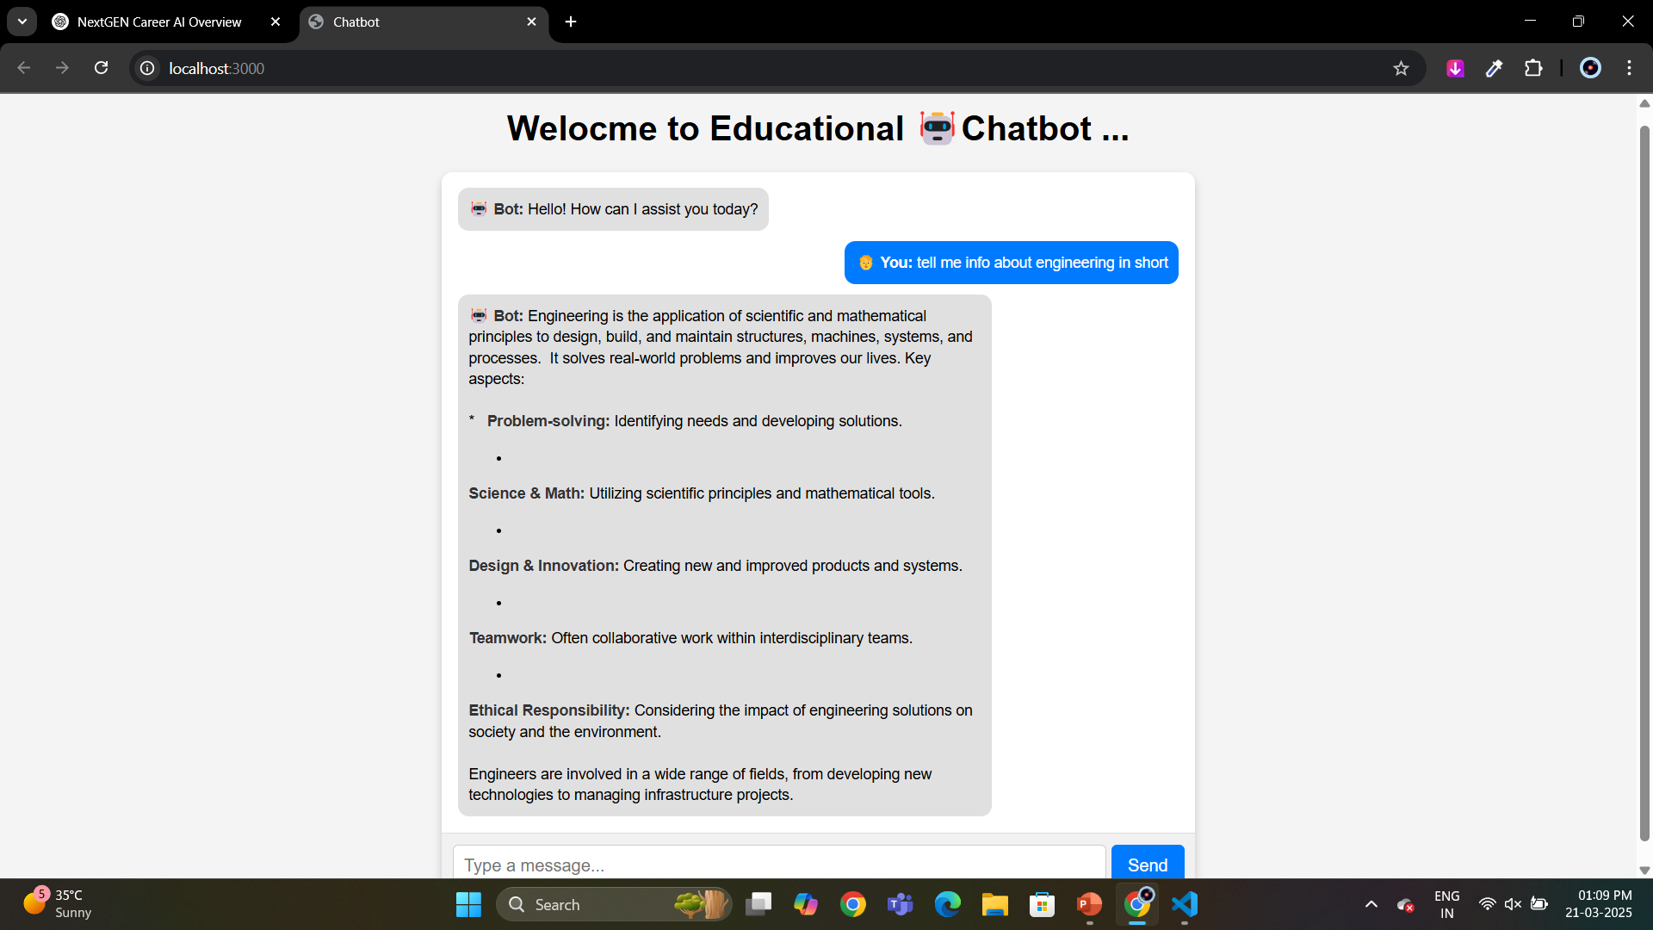
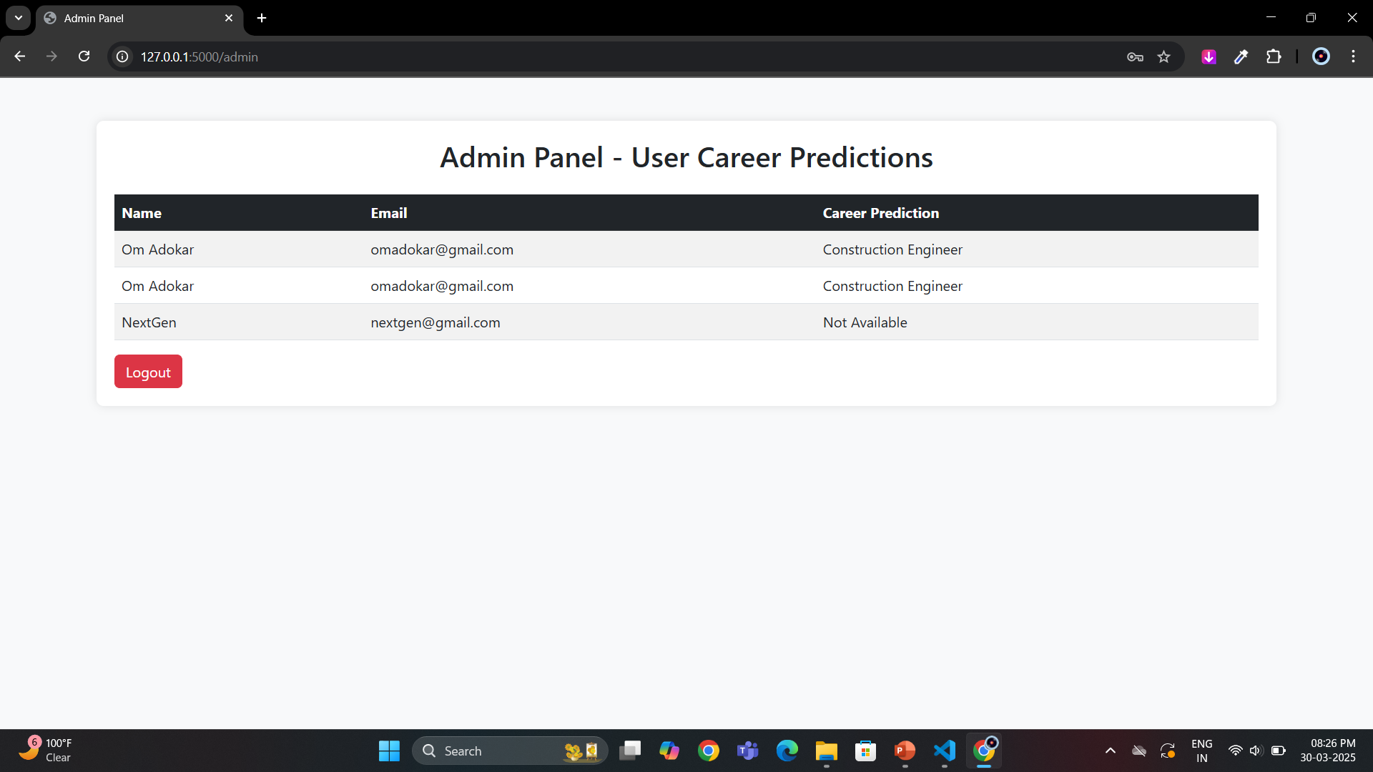
Screen shots/ Results
PRPCEM, CSE Department
1

Slide 12
Advantages & Disadvantages
Advantages:
Personalized Career Guidance – Tailored recommendations based on student interests & strengths.
Instant & Time-Saving – Provides career advice instantly, reducing the need for manual counseling.
Accessible Anywhere – Students can access career guidance remotely.
Data-Driven Insights – Ensures reliable career suggestions based on analyzed trends.
User-Friendly Interface – Easy-to-use dashboard for career recommendations.
Disadvantages
Limited Data Diversity – Less common careers may not be accurately predicted.
User Input Dependency – Incorrect inputs can lead to inaccurate results.
No Human Emotion Understanding – Lacks emotional intelligence like human counselors.
Potential Bias in Predictions – May favor common professions over niche fields.
Requires Regular Updates – Career trends change, demanding frequent model updates.
PRPCEM, CSE Department
1

Slide 13
Conclusion & Future scope
Conclusion:
The AI-powered Career Guidance System efficiently provides students with personalized career recommendations based on their interests, strengths, and skills.
Using Machine Learning the system ensures accurate career predictions.
The chatbot-based system enhances accessibility, allowing students to explore career options anytime, anywhere.
This project bridges the gap between students and career counselors, helping them make informed decisions.
Future Scope:
Integration with Industry Trends – The system can be updated with real-time job market trends and emerging careers.
Enhanced NLP Chatbot – Improving chatbot responses using advanced natural language processing for better interaction.
Integration with Universities & Companies – Connecting students with educational institutions and job opportunities.
Mobile App Development – Making the system mobile-friendly for better accessibility.
Multilingual Support – Expanding the chatbot's capabilities to support multiple languages.
PRPCEM, CSE Department
1

Slide 14
References
H. Huang, S. Ding, Y. Zhang and D. Chen, "The impact of STEM Courses and STEM Interests on the STEM Major Intention of middle school students with the moderating effect of Career Planning Courses," 2024 International Symposium on Educational Technology (ISET), Macau, Macao, 2024, pp. 225-229, doi: 10.1109/ISET61814.2024.00051.
G. Santi and A. Carraro, "Academic Career Assistance Services for Student-Athletes in South Tyrol: A Study Protocol," 2023 IEEE International Workshop on Sport, Technology and Research (STAR), Cavalese - Trento, Italy, 2023, pp. 77-80, doi: 10.1109/STAR58331.2023.10302646.
H. Jiang, L. Zhang and W. Lv, "The impact of STEM Competitions on Students' Career Interest and Persistence in STEM," 2022 4th International Conference on Computer Science and Technologies in Education (CSTE), Xi'an, China, 2022, pp. 279-283, doi: 10.1109/CSTE55932.2022.00058.
N. Mavuso, N. Jere and D. Van Greunen, "A Systematic Review of Customised Career Recommender Systems for South Africa," 2023 2nd Zimbabwe Conference of Information and Communication Technologies (ZCICT), Gweru, Zimbabwe, 2023, pp. 1-7, doi: 10.1109/ZCICT59466.2023.10528488.
N. Soni, N. Nishant, M. Singh, S. Ansari, A. T. Siddiqui and S. A. Ansar, "Leveraging Machine Learning for Career Prediction and Resume Analysis in Career Assist," 2023 10th IEEE Uttar Pradesh Section International Conference on Electrical, Electronics and Computer Engineering (UPCON), Gautam Buddha Nagar, India, 2023, pp. 1009- 1014, doi: 10.1109/UPCON59197.2023.10434306.
PRPCEM, CSE Department
1

Slide 15
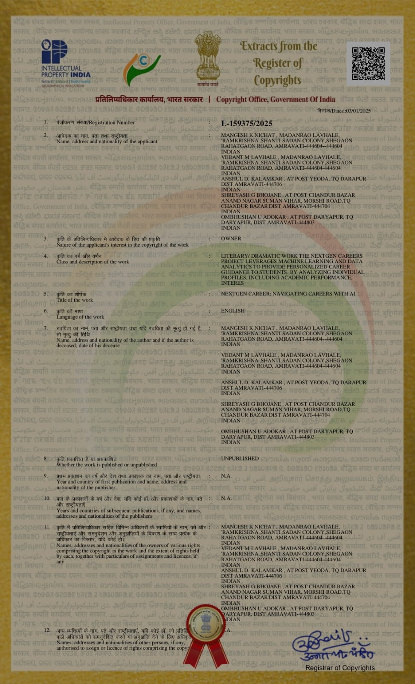
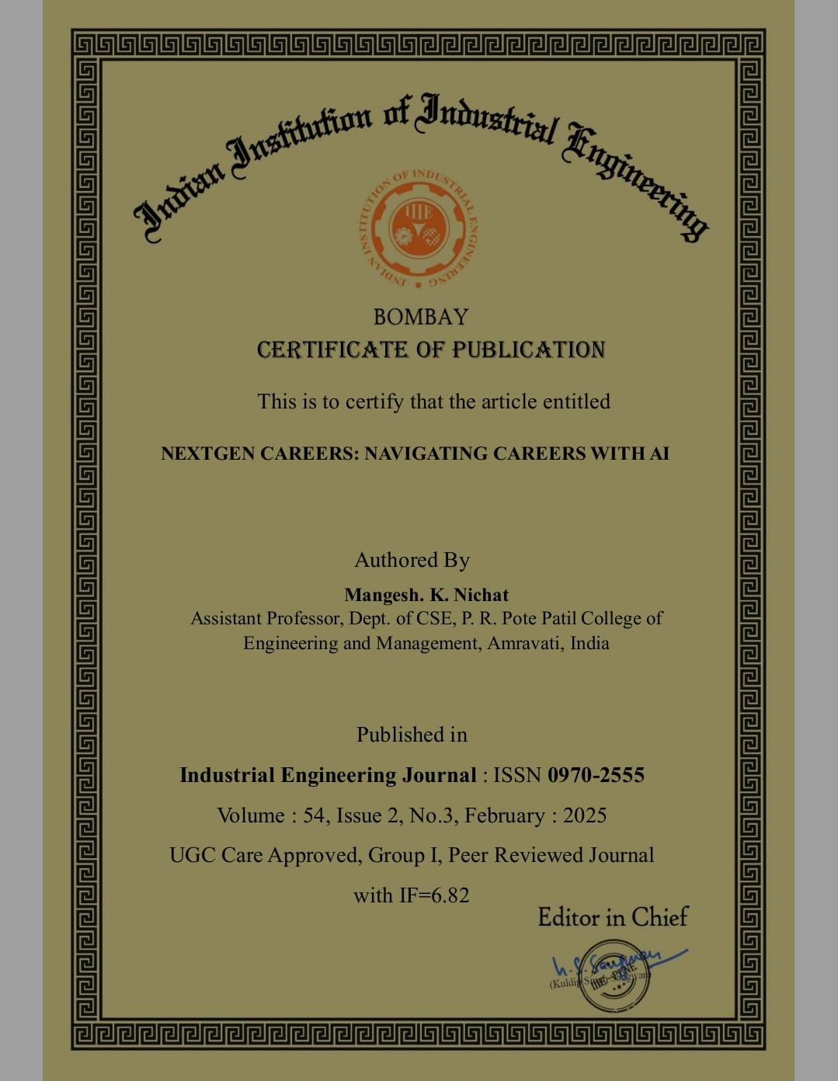
Publications/CopyRight/Patents
PRPCEM, CSE Department
1

